Slide 1
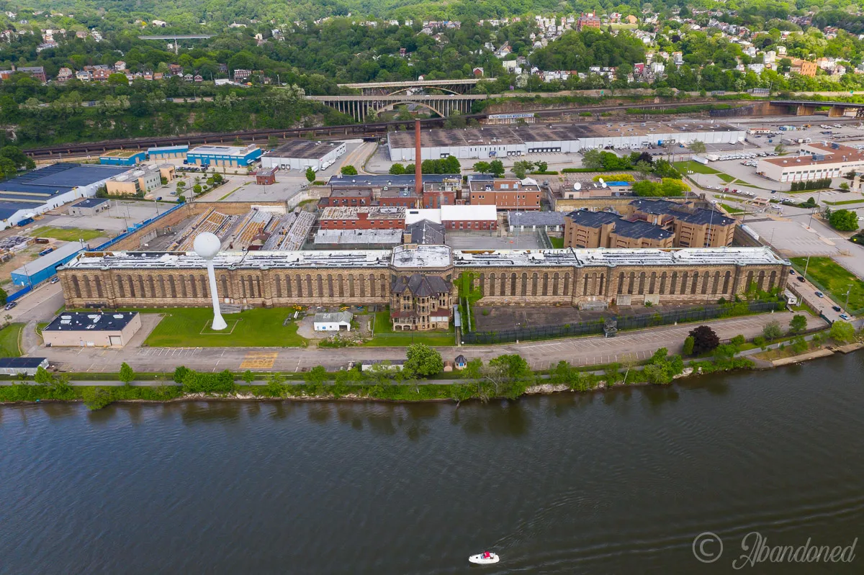
From Prison to Prosperous Community
Michael Rodriguez - Planning Consultant, Smart Cities Institute

Slide 2
It is Time to Give a Prison a New Purpose
Strategy
Transform the site to a place to live and work but also a destination that bring in others
Recommendation
Leverage sustainable development to connect communities or transform corridors
Implications
Forming new connections across neighborhoods will bring greater economic vitality

Slide 3
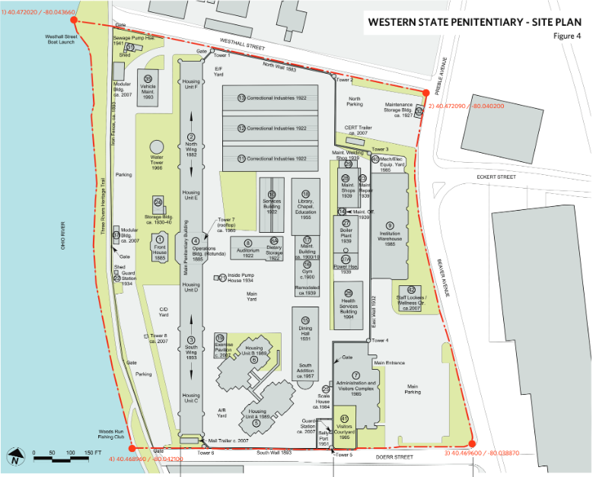
Repurposing the Site has Hit Hiccups
There has yet to have been a full commitment from all stakeholders on getting the site ready to be redeveloped for new opportunities.
Some reasons may include:
Differing opinions on repurposing/preservation
Questions of who can manage the work
Unclear timelines
First Wing Constructed
Prison Funding Shifts
Temporary Closure
Reopened
Ceased Operations
Nonprofit Deal Fell Through
1878
1900
2005
2007
2017
2019

Slide 4
The Marshall-Shadeland Community is Invested in Revitalization the Region Starting with Economic Opportunities - And So Should You
A New Sustainable Community
Transit Options
Economic Development
Community Planning
River and Transit Connections
Housing
A Destination

Slide 5
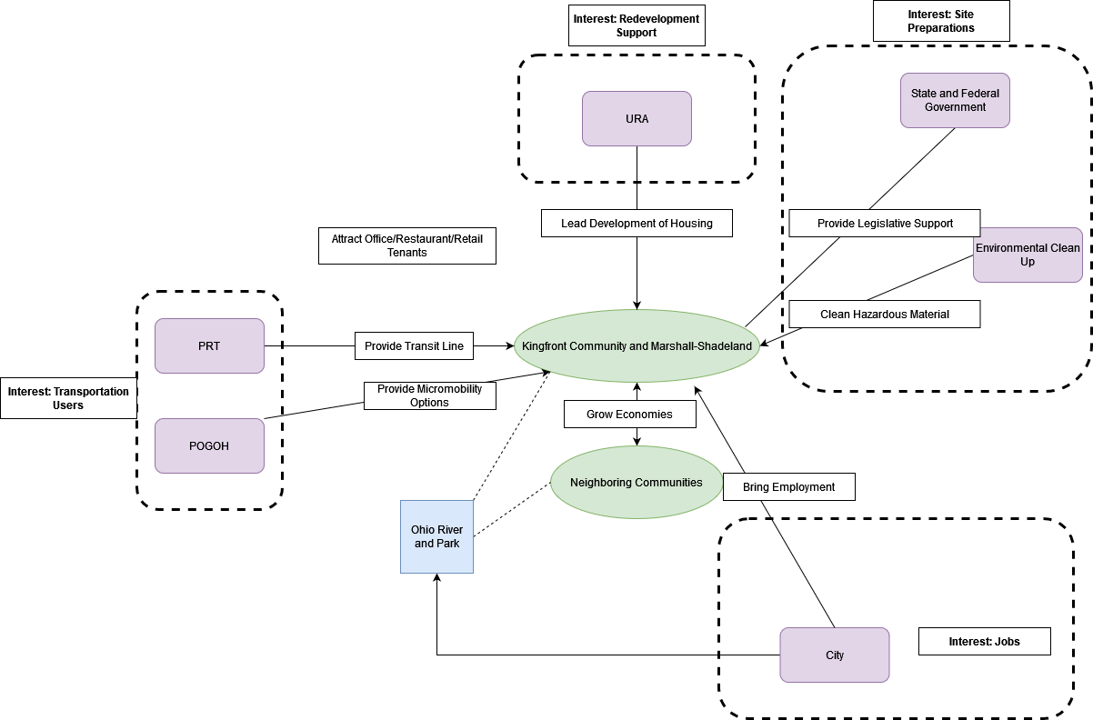
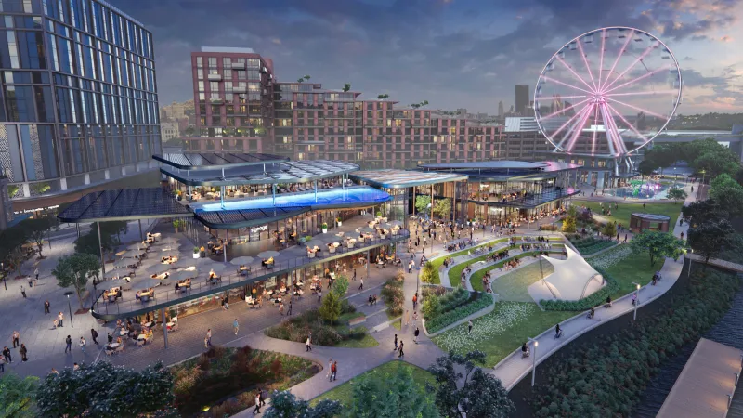
Together We Can Drive an Economic Engine
Connect the Kingfront Community to Esplanade in Chateau

Slide 6
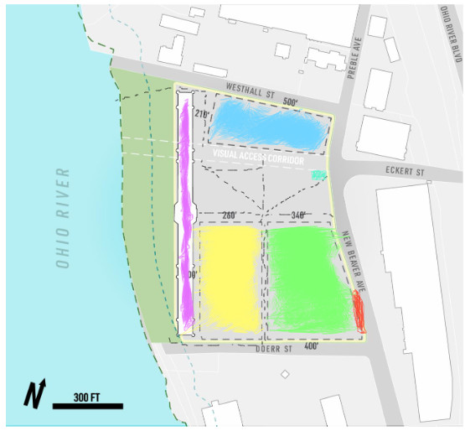
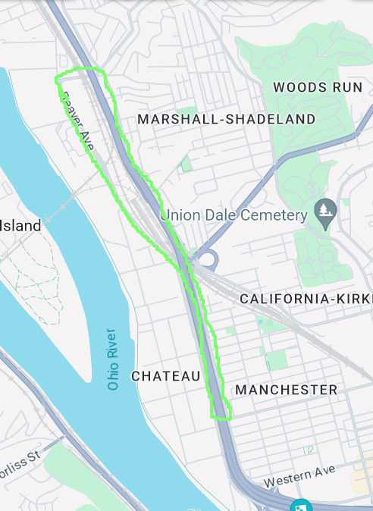
Bridge Communities with Place Making
Community center to help individuals overcome barriers to work
Reimagine land to the west as a school building
Work with PRT and POGOH to connect the neighborhood with communities to the south
Preserve land to the west as a public park with trail connection
Multifamily Hosing
School House
Sports Complex/Community Center
Office/Restaurant/Retail
POGOH Station
Connector Stop
Walking Paths
Public Park and Trail
Proposed Connector Transit Line
Bridge the communities of Marshall-Shadeland, Chateau, and Manchester together

Slide 7
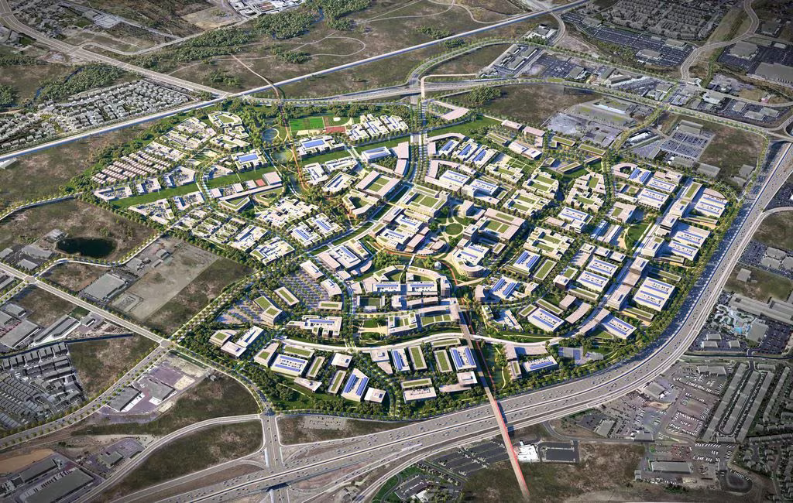
Utah Transforming Prison into Regional Connection and Economic Center
Prioritizing a mix of housing, commercial and transportation-centered development
Construction to start 2025-26
Between two major hubs
Aimed to be a self sufficient city
Focused on becoming an economic engine for the Draper community

Slide 8
Align Our Playbook With Utah’s
 | Marshall-Shadeland | Draper, Utah
History | Aging prison near communities interested in new opportunities | Prison surrounded by empty acres of land
Aim | Provide a location to live and work while connecting with other communities to boost economic vitality | Transform the region into a new economic hub and self sufficient community
Challenges | Stakeholder alignment | Time for construction

Slide 9
The Status Quo is Not Good Enough
Without a new sustainable development, Marshall-Shadeland:
Lacks transit and river connections
Lacks economic and destination qualities
Lacks opportunities for the community

Slide 10
Let the Community Shape the Region, Before the Region Shapes the Community
The region of Marshall-Shadeland has been in its own cage being partitioned into housing and industrial areas seeing a declining population, mostly due to infrastructure
Leveraging the SCI site as a sustainable development can allow the community to be reconnected to the river, other communities to the south, and to the local economy with new job opportunities

